Slide 1

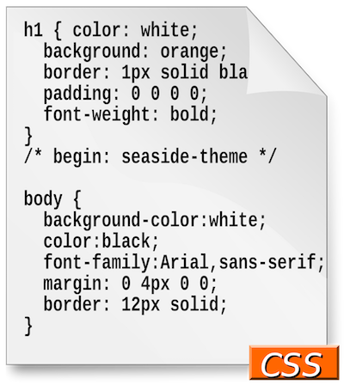
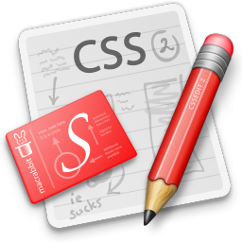
CHAPTER THREE Cascading Style Sheets (CSS)

Slide 2
Outline
CSS Basics
Introduction to CSS
CSS Syntax (CSS Selectors and Declarations)
Attaching CSS with HTML (External , Embedded and Inline)
Style Sheet Rules
Style Inheritance
Style Rules Precedence
Style Properties
Foreground and Background Properties
Font and Text Properties
CSS Box Model
Table Styling Properties
More On Styling List (Creating Navigation bars)
Layout and Positioning Properties

Slide 3
What is CSS?
It is a simple design language intended to simplify the process of making webpages presentable.
It is a styling language
CSS handles the look and feel part of a webpage
CSS is easy to learn and understand but it provides powerful control over the presentation of an HTML document
Most commonly, CSS is combined with the markup languages HTML or XHTML

Slide 4
What is CSS?
Importance of Cascading Style Sheets (CSS)
Used to describe the arrangement of documents
Define sizes, spacing, fonts, colors, layout, etc.
Improve content accessibility
Improve flexibility
CSS Properties affect how elements are displayed
Times Save
Notes:
Visual Presentation: CSS allows you to control the visual presentation of HTML content. By using CSS properties such as color, font size, spacing, and layout, you can enhance readability and make content more visually appealing. This is especially important for users with visual impairments or reading difficulties.
Improve flexibility means:
Separation of Concerns: CSS allows separation of style from structure and behavior. This separation makes code more modular and easier to maintain, as changes to the visual presentation can be made in the CSS file without modifying the HTML structure or JavaScript functionality.

Slide 5
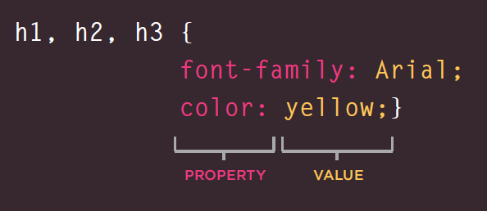
CSS Syntax
Some CSS styles are inherited and some not
Text-related properties are inherited font-size, font-family, line-height, text-align, list-style, etc.
Box-related and positioning styles are not inherited - width, height, border, margin, padding, position, float, etc.
CSS declarations sit inside curly brackets and each is made up of two parts: property and a value, separated by a colon.
You can specify several properties in one declaration, each separated by a semi-colon.
Notes:
Examples of non-inherited properties include background-color, border, margin, padding, width, height, and many others.
These properties must be explicitly applied to each element you want them to affect.

Slide 6
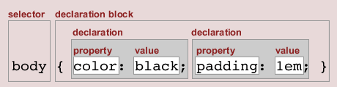
Style Sheets Syntax
Stylesheets consist of rules, selectors, declarations, properties and values
Selectors are separated by comma
Declarations are separated by semicolons
Properties and values are separated by colons
h1,h2,h3 { color: green;
font-weight: bold;
}

Slide 7
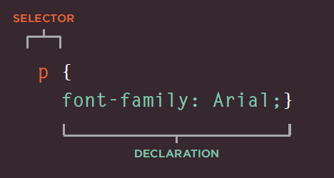
Selectors
Selectors used to determine on which element the rule will be applied:
All elements of specific type (tag)
Those that match a specific attribute (id, class)
Elements may be matched depending on how they are nested in the document tree (HTML)
Examples:
p { text-align: center; color: red; }
#para1 { text-align: center; color: red; }

Slide 8
Selectors (2)
Three primary kinds of selectors:
By tag (type selector):
By element id:
By element class name (only for HTML):
Selectors can be combined with commas:
This will match <h1> tags, elements with class link, and element with id top-link
h1 { font-family: verdana,sans-serif; }
#element_id { color: #ff0000; }
.myClass {border: 1px solid red}
h1, .link, #top-link {font-weight: bold}

Slide 9
Values in the CSS Rules
Colors are set in RGB format (decimal or hex):
Example: #a0a6aa = rgb(160, 166, 170)
Predefined color : black, blue, etc.
Numeric values are specified in:
Pixels, e.g. 12px,
Points, inches, centimeters, millimeters
E.g. 10pt, 1in, 1cm, 1mm
Percentages, e.g. 50%
Zero can be used with no unit: border: 0;

Slide 10
Linking HTML and CSS
HTML (content) and CSS (presentation) can be linked in three ways:
Inline: the CSS rules in the style attribute
No selectors are needed
Embedded: in the <head> in a <style> tag
External: CSS rules in separate file (best)
Usually a file with .css extension
Linked via <link rel="stylesheet" href=…> tag or @import directive in embedded CSS block

Slide 11
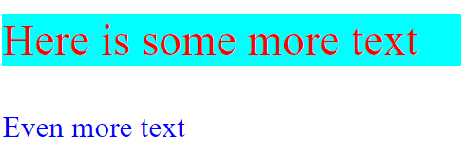
Inline Styles: Example
inline-styles.html
<!DOCTYPE html">
<html xmlns="http://www.w3.org/1999/xhtml">
<head>
<title>Inline Styles</title>
</head>
<body>
<p>Here is some text</p>
<!--Separate multiple styles with a semicolon-->
<p style="font-size: 30pt">Here is some
more text</p>
<p style="font-size: 20pt;color:
#0000FF" >Even more text</p>
</body>
</html>

Slide 12
Embedded Styles
Embedded/internal- in the HTML in the <style> tag:
The <style> tag is placed in the <head> section of the document
Used for document-specific styles
<style>
...
<.style

Slide 13
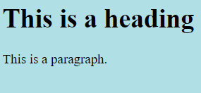
Embedded Styles: Example
<!DOCTYPE html> <html> <head> <style> body {background-color: powderblue;} h1 {color: blue;} p {color: red;} </style> </head> <body> <h1>This is a heading</h1> <p>This is a paragraph.</p> </body> </html>

Slide 14
External CSS Styles
External linking
Separate pages can all use a shared style sheet
Only modify a single file to change the styles across your entire Web site (see http://www.csszengarden.com/)
link tag (with a rel attribute)
Specifies a relationship between current document and another document
<link rel="stylesheet" type="text/css" href="styles.css">
The <link> element should be in the head and tells the browser that we have a stylesheet, using the rel attribute, and the location of that stylesheet as the value of the href attribute. You can test that the CSS works by adding a rule to styles.css.
Check the example on the next slide.

Slide 15
External Styles: Example (2)
external-styles.html
styles.css
body
{
background-color: pink;
} h1 {
color: blue;
} p {
color: red;
}
<!DOCTYPE html> <html> <head> <link rel="stylesheet" href="styles.css"> </head> <body> <h1>This is a heading</h1> <p>This is a paragraph.</p> </body> </html>

Slide 16
Introduction to CSS Inheritance
Inheritance is one feature that leverages the ability to use a styling feature of the parent entity in a child entity.
This gives ease to the coding, as a common property need not be styled twice or multiple times.
The use of ’inherit’ keyword makes sure that the property is adopted from the parent entity to the child entity.
Notes:
By using inheritance, developers can write cleaner and more modular code, as they only need to define styles once at the appropriate level in the document hierarchy.
This not only saves time but also makes it easier to update styles globally by simply modifying the parent elements.

Slide 17

Example:
<body>
<div>
Here is <span>a span element</span> which is blue, as span elements are set to be.
</div>
<div class="extra" style="color:green">
Here is <span>a span element</span> which is green, because it inherits from its parent.
</div>
<div style="color:red">
Here is <span>a span element</span> which is blue, as span elements are set to be.
</div>
</body>
</html>
<!DOCTYPE html>
<html>
<head>
<style>
span {
color: blue;
border: 1px solid black;
}
.extra span {
color: inherit;
}
</style>
</head>

Slide 18
Style Rules Precedence
Every CSS selector has its place in the specificity hierarchy.
There are four categories which define the specificity level of a selector:
Inline styles - Example: <h1 style="color: pink;">
IDs - Example: #navbar
Classes, pseudo-classes, attribute selectors - Example: .test, :hover, [href]
Elements and pseudo-elements: Example: h1, ::before
Notes:
Pseudo-classes: Pseudo-classes are keywords that specify a special state of an element. They are preceded by a colon (:) in CSS. Common pseudo-classes include :hover, :active, :focus, which target elements based on user interaction, and :nth-child(), which selects elements based on their position within a parent.
Attribute Selectors: Attribute selectors target elements based on the presence or value of their attributes. They are enclosed in square brackets ([]). For example, [href] targets all elements with an href attribute, and [type="checkbox"] targets all checkbox input elements. Attribute selectors provide a flexible way to style or script elements based on their attributes.
Elements and Pseudo-elements:
Example: h1, ::before
Pseudo-elements: Pseudo-elements allow you to style specific parts of an element. They are preceded by double colons (::) in CSS. Common pseudo-elements include ::before and ::after, which allow you to insert content before or after the content of an element, respectively. Pseudo-elements are often used for decorative purposes or to add additional content dynamically.
Understanding these CSS concepts allows you to efficiently target and style different elements within HTML documents.

Slide 19
How to Calculate Specificity?
What is Specificity?
If there are two or more CSS rules that point to the same element, the selector with the highest specificity value will "win", and its style declaration will be applied to that HTML element
Start at 0, add 100 for each ID value, add 10 for each class value (or pseudo-class or attribute selector), add 1 for each element selector or pseudo-element.
Note 1: Inline style gets a specificity value of 1000, and is always given the highest priority!
Note 2: There is one exception to this rule: if you use the !important rule, it will even override inline styles!
Notes:
Specificity is the algorithm that the browser uses to decide which property value is applied to an element. If multiple style blocks have different selectors that configure the same property with different values and target the same element, specificity decides the property value that gets applied to the element. Specificity is basically a measure of how specific a selector's selection will be:

Slide 20
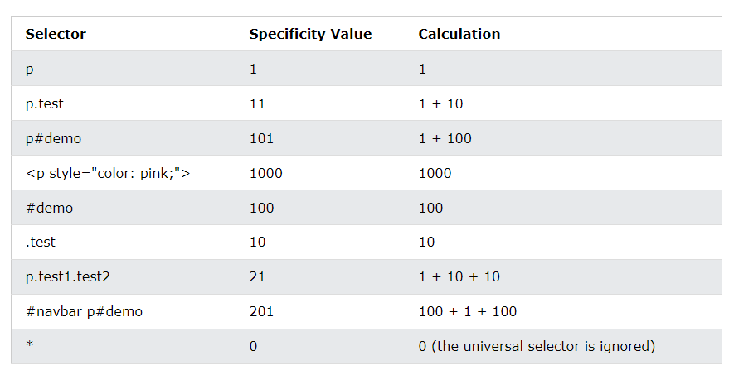
examples on how to calculate specificity values:

Slide 21
Cont..
Example
A: h1
B: h1#content
C: <h1 id="content" style="color: pink;">Heading</h1>
The specificity of A is 1 (one element selector)
The specificity of B is 101 (one ID reference + one element selector)
The specificity of C is 1000 (inline styling)
Since the third rule (C) has the highest specificity value (1000), this style declaration will be applied (inline style).
What if Equal specificity? (do the latest rule wins?)
h1 {background-color: yellow;} h1 {background-color: red;}

Slide 22
Cont..
<!DOCTYPE html>
<html>
<head>
<style>
.test {color: green;}
p {color: red;}
</style>
</head>
<body>
<p class="test">Hello World!</p>
</body>
</html>
Example 2
In this example, we have added a class selector (named "test"), and specified a green color for this class. The text will now be green (even though we have specified a red color for the element selector "p"). This is because the class selector is given higher priority:

Slide 23
Cont..
<!DOCTYPE html>
<html>
<head>
<style>
#demo {color: blue;}
.test {color: green;}
p {color: red;}
</style>
</head>
<body>
<p id="demo" class="test">Hello World!</p>
</body>
</html>
Example 3
In this example, we have added the id selector (named "demo"). The text will now be blue, because the id selector is given higher priority:
Example 4
<!DOCTYPE html>
<html>
<head>
<style>
h1 {background-color: yellow;}
h1 {background-color: red;}
</style>
</head>
<body>
<h1>This is heading 1</h1>
</body>
</html>
Notes:
Equal specificity: the latest rule wins - If the same rule is written twice into the external style sheet, then the latest rule wins: ex4

Slide 24
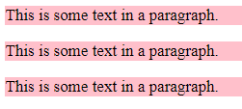
!important?
<style>
#myid {background-color: blue;}
.myclass { background-color: gray;}
p {background-color: pink !important;}
</style>
<body>
<p>This is some text in a paragraph.</p>
<p class="myclass">This is some text in a paragraph.</p>
<p id="myid">This is some text in a paragraph.</p>
</body>
#myid { background-color: blue; } .myclass { background-color: gray; } p { background-color: red !important; }

Slide 25
Text-related CSS Properties
color – specifies the color of the text
font-size – size of font: xx-small, x-small, small, medium, large, x-large, xx-large, smaller, larger or numeric value
font-family – comma separated font names
Example: verdana, sans-serif, etc.
There should always be at least one generic font
font-weight can be normal, bold, bolder, lighter or a number in range [100 … 900]

Slide 26
CSS Rules for Fonts (2)
font-style
Values: normal, italic, oblique
text-decoration
Values: none, underline, line-trough, overline, blink
text-align
Values: left, right, center, justify

Slide 27
Shorthand Font Property
font
Shorthand rule for setting multiple font properties at the same time
is equal to writing this:
font:italic normal bold 12px/16px verdana
font-style: italic;
font-variant: normal;
font-weight: bold;
font-size: 12px;
line-height: 16px;
font-family: verdana;

Slide 28
Backgrounds
The CSS background properties are used to add background effects for elements.
background-image
URL of image to be used as background, e.g.:
background-color
Using color
background-repeat
repeat-x, repeat-y, repeat, no-repeat
background-attachment
fixed / scroll
background-image:url("back.gif");

Slide 29
Backgrounds (2)
Background-position: specifies vertical and horizontal position of the background image
Vertical position: top, center, bottom
Horizontal position: left, center, right
Both can be specified in percentage or other numerical values
Examples:
Position the background image in the top-right corner:
body { background-image: url("img_tree.png"); background-repeat: no-repeat; background-position: right top; }

Slide 30
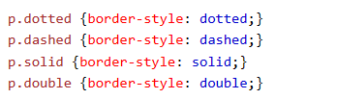
Borders
The CSS border properties allow you to specify the style, width, and color of an element's border.
Border-width: thin, medium, thick or numerical value (e.g. 10px)
Border-color: color alias or RGB value
border-style: none, hidden, dotted, dashed, solid, double, groove, ridge, inset, outset
Each property can be defined separately for left, top, bottom and right
Example: border-style:

Slide 31
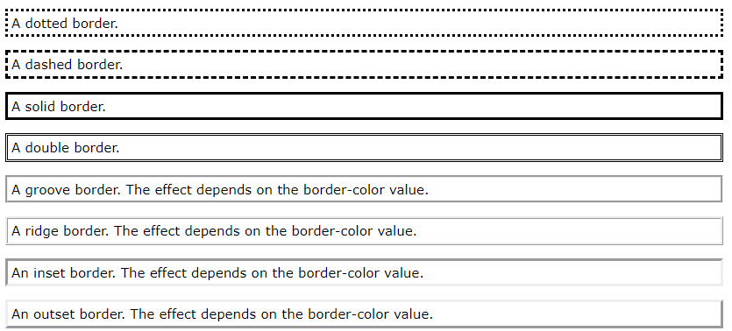
Borders

Slide 32
Width and Height
width – defines numerical value for the width of element, e.g. 200px
height – defines numerical value for the height of element, e.g. 100px
By default the height of an element is defined by its content
Inline elements do not apply height, unless you change their display style

Slide 33
Margin and Padding
margin and padding define the spacing around the element
Margin is the spacing outside of the border
Padding is the spacing between the border and the content
Numerical value, e.g. 10px
Can be defined for each of the four sides separately - margin-top, padding-left, …
Set different margins for all four sides of a <p> element:
p { margin-top: 100px; margin-bottom: 100px; margin-right: 150px; margin-left: 80px; }

Slide 34
Margin and Padding: Short Rules
margin: 5px;
Sets all four sides to have margin of 5 px;
margin: 10px 20px;
top and bottom to 10px, left and right to 20px;
margin: 5px 3px 8px;
top 5px, left/right 3px, bottom 8px
margin: 1px 3px 5px 7px;
top, right, bottom, left (clockwise from top)
Same for padding

Slide 35
Positioning
Position: defines the positioning of the element in the page content flow
The value is one of:
static (default): Static positioned elements are not affected by the top, bottom, left, and right properties.
relative – relative position according to where the element would appear with static position
absolute – position according to the innermost positioned parent element
fixed – same as absolute, but ignores page scrolling
Notes:
HTML elements are positioned static by default.
Static positioned elements are not affected by the top, bottom, left, and right properties.
An element with position: static; is not positioned in any special way; it is always positioned according to the normal flow of the page:
An element with position: fixed; is positioned relative to the viewport, which means it always stays in the same place even if the page is scrolled. The top, right, bottom, and left properties are used to position the element.
An element with position: absolute; is positioned relative to the nearest positioned ancestor (instead of positioned relative to the viewport, like fixed).
However; if an absolute positioned element has no positioned ancestors, it uses the document body, and moves along with page scrolling.

Slide 36
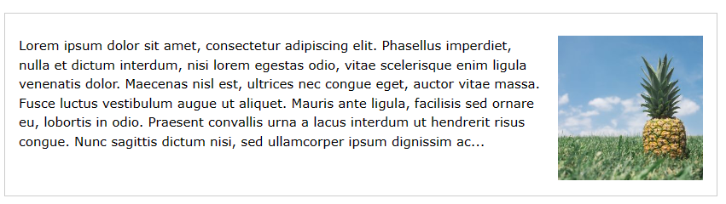
Float
float: the element “floats” to one side
left: places the element on the left and following content on the right
right: places the element on the right and following content on the left
margins of floated elements do not collapse
floated inline elements can apply height
The following example specifies that an image should float to the right in a text:
img { float: right; }

Slide 37
Clear
Clear
When we use the float property, and we want the next element below (not on right or left), we will have to use the clear property.
Possible values: left, right, both
This example clears the float to the left. Here, it means that the <div2> element is pushed below the left floated <div1> element:
div1 { float: left; } div2 { clear: left; }

Slide 38
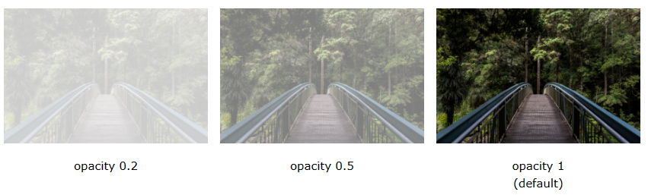
Opacity
Opacity: specifies the opacity of the element
Floating point number from 0.0 to 1.0
For old Mozilla browsers use –moz-opacity
For IE use filter: alpha(opacity=value) where value is from 0 to 100;
The opacity property specifies the opacity/transparency of an element.
img { opacity: 0.5; }

Slide 39
Visibility
Visibility
Determines whether the element is visible
hidden: element is not rendered, but still occupies place on the page (similar to opacity:0)
visible: element is rendered normally
Notes:
The visibility property specifies whether or not an element is visible.
Tip: Hidden elements take up space on the page. Use the display property to both hide and remove an element from the document layout!

Slide 40
Display
Display: controls the display of the element and the way it is rendered and if breaks should be placed before and after the element
inline: no breaks are placed before and after (<span> is an inline element)
block: breaks are placed before AND after the element (<div> is a block element)
none: element is hidden and its dimensions are not used to calculate the surrounding elements rendering (differs from visibility: hidden!)

Slide 41
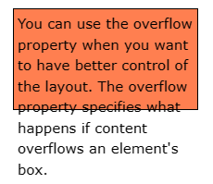
Overflow
Overflow: defines the behavior of element when content needs more space than you have specified by the size properties or for other reasons. Values:
visible (default) – content spills out of the element
auto - show scrollbars if needed
scroll – always show scrollbars
hidden – any content that cannot fit is clipped
div { width: 200px; height: 65px; background-color: coral; overflow: visible; }
div { overflow: hidden; }

Slide 42
Other CSS Properties
Cursor: specifies the look of the mouse cursor when placed over the element
Values: crosshair, help, pointer, progress, move, hair, col-resize, row-resize, text, wait, copy, drop, and others
white-space – controls the line breaking of text. Value is one of:
nowrap – keeps the text on one line
normal (default) – browser decides whether to brake the lines if needed
Pre: Whitespace is preserved by the browser. Text will only wrap on line breaks. Acts like the <pre> tag in HTML

Slide 43
Table Styling Properties
Table Borders
table, th, td { border: 1px solid; }
Table width, height
table { width: 100%;
height:40%; }

Slide 44
Cont.
CSS Table Alignment
td { text-align: center;
vertical-align: bottom; }

Slide 45
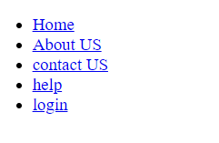
CSS: Creating Navigation Bars
<ul id="navbar">
<li><a href="/tests">Home</a></li>
<li><a href="/studyroom">About US</a></li>
<li><a href="/flashcards">contact US</a></li>
<li><a href="/library">help</a></li>
<li><a href="/testimonials">login</a></li>
</ul>

Slide 46

Cont..
#navbar {
list-style-type: none;
margin: 0;
padding: 0;
width: 200px;
background-color: #EEEEEE;
}

Slide 47
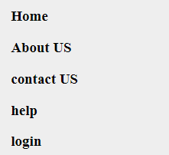
Cont..
ul#navbar li a {
display: block;
color: #000000;
font-weight:bold;
padding: 8px 16px;
text-decoration: none;
}

Slide 48
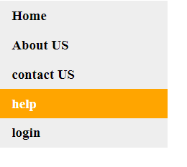
Cont..
ul#navbar li a:hover {
background-color: orange;
color: white;
}

Slide 49
Cont..
ul#navbar li {
display: inline;}

Slide 50
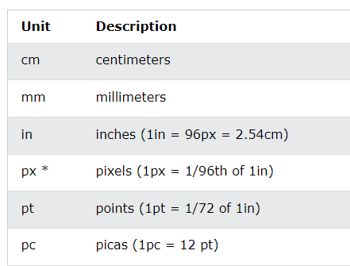
CSS Measuring Units
CSS Units
CSS has several different units for expressing a length.
Many CSS properties take "length" values, such as width, margin, padding, font-size, etc.

Slide 51
Benefits of using CSS
More powerful formatting than using presentation tags
Your pages load faster, because browsers cache the .css files
Increased accessibility, because rules can be defined according given media
Pages are easier to maintain and update

Slide 52
Reading Assignment
How to use Font Awesome Icons?
CSS Box model?

Slide 53

Thanks
?

